Slide 1

Hope Foundation’s
International Institute of Information Technology,
Pune - 411057
Academic Year 2020-21 (Sem-II)
Department of Computer Engineering
Course : - Seminar and Technical Communication
Drowsiness Detection For Road Safety.
Presented by
Name : Nachiket S Patil
Class : T.E. (Computer Engineering)
Roll No : TE020
Review No. : 2
Guided By:
Name: Prof. Prashant Gadakh

Slide 2
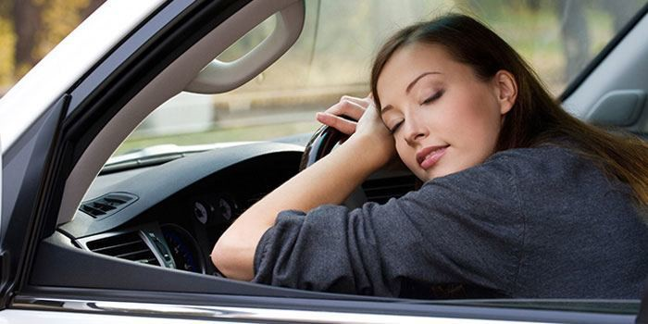
Contents
•Introduction
•Motivation
•Literature Survey
•Summary/findings of Literature Survey
•Objectives
Architecture of System
•Details of design/technology/analytical and/or experimental work
•Advantages, Disadvantages/Limitations of System
•Conclusion and Future work
•References

Slide 3
Introduction
Drowsy driving is the dangerous combination of driving and sleepiness or fatigue. This usually happens when a driver has not slept enough, but it can also happen because of untreated sleep disorders, medications, drinking alcohol, or shift work.
Every year thousands of people in India lose their lives due to traffic accidents. The role of human factor plays a key role in the accidents. In general, the driver fatigue alone accounts for around 25 percent of the road accidents and up to 60 percent of road accidents result in death or serious injury [1].
So a drivers' drowsiness state is a major factor in severe road accidents that claims thousands of lives every year.

Slide 4
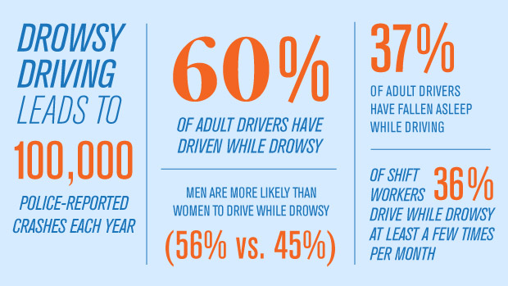
INTERESTING FACT

Slide 5

Motivation!!

Slide 6
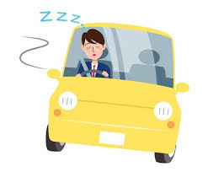
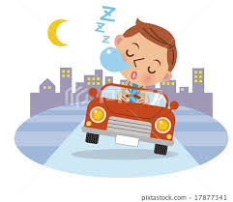
72,0000
44,000
800
. National Highway Traffic Safety Administration reported that in 2013
Number of Accidents
due to Drowsiness
Injuries Due to these Accidents
Deaths

Slide 7
Motivation For Selecting Topic
Advancement in Technology.
In the recent years, use of intelligent algorithms in cars has developed considerably. These systems use WSNs to monitor and transmit the condition of the car and the driver. Smart cars that use software techniques to control engine speed, steering, transmission, brake etc. has improved the quality of driving significantly.
Improvement in Safety.
So, in order to solve this problem, an idea came up to create a software product which will raise a alarm when the driver is feeling drowsy using machine learning and artificial intelligence.

Slide 8
Literature Survey
S.N. | Title of Paper | Journal/Conference Name/Year of publication | Author Names | Summary of Paper
1 | Real Time Driver Drowsiness Detection Based on Driver’s Face Image Behavior Using a System of Human Computer Interaction Implemented in a Smartphone. | Advances in Intelligent Systems and Computing · January 2018 | Franklin Silva, Eddie Galarza | Surveillance System to detect and alert the driver about the presence of drowsiness.
2 | Facial Features Monitoring for Real Time Drowsiness Detection. | 2016 12th International Conference on Innovations in Information Technology (IIT) | Manu B.N | This paper describes an efficient method for drowsiness detection by three well defined phases.

Slide 9
Literature Survey
S.N. | Title of Paper | Journal/Conference Name/Year of publication | Author Names | Summary of Paper
3. | Real-time Driver Drowsiness Detection for Android Application | The 9th International Conference on mbient Systems, Networks, and Technologies (ANT 2018) | Rateb Jabbara*, Khalifa Al-Khalifaa,b, Mohamed Kharbechea, Wael Alhajyaseena, Mohsen Jafaric, Shan Jiangc | This approach is based on a deep learning method that can be implemented on Android applications with high accuracy.
4. | Real-Time Driver-Drowsiness Detection System Using Facial Features | Accepted by IEEE and to be published in future issue. | WANGHUA DENG1 RUOXUE WU12 | New detection model for facial features with 68 key points and by combining the features of eyes and mouth.
5. | Real Time Drowsiness Detection using Eye Blink Monitoring | 2015 National Software Engineering Conference (NSEC 2015) | Amna Rahman Mehreen Sirshar Aliya Khan | An eye blink monitoring algorithm that uses eye feature points to determine the open or closed state of the eye and activate an alarm if the driver is drowsy.

Slide 10
1.Summary/Findings of Literature Survey.
Let’s start with the survey..

Slide 11
Literature Survey
Drowsiness is a physiological state with a tendency to fall asleep. Technically, drowsiness is different from the fatigue that is the lack of willingness to continue performing the same activity.
Fatigue occurs by performing tasks that are always performed in the same way using the same muscle groups, their repetition rate is high and are usually performed by adopting forced postures such as monitoring a screen
A person may be fatigued without being drowsy, but conditions that produce fatigue such as driving cars over great distances unmask the presence of physiological drowsiness, but do not cause fatigue.

Slide 12
Literature Survey.
For drowsiness detection, the research paper(2) presents a new method which monitors the status of eyes and mouth and does not require sensors or wearables devices and works well under all illumination conditions.
Now we will see, useful features to detect whether the driver is feeling drowsy.

Slide 13
Signs of Drowsiness
Head Tilt
Frequent Blinkings
Repeated Yawning
Rubbing Eyes

Slide 14
LET’S REVIEW SOME PARAMETERS TO DETECT DROWSINESS
Yawn Detection
The opening of driver’s mouth is greater while yawning and thus the frequency of yawning is measured to detect drowsiness.
Eye detection
PERCLOS(Percent of time eyelids are closed) is used to detect drowsiness by measuring the eye blinking frequency and time interval of closing eyes.
Head tilt Detection
The head tilt while the driver is going asleep is also an important factor to detect drowsiness.
Pressure on Steering wheel.
By using pressure sensor on steering wheel.
Heart rate
By using watch which detects the heart rate and analyses the pattern to detect drowsiness.
Facial expressions
By detecting changes in the facial expression like smiling,etc and the movement of lips.

Slide 15
Objectives
Let’s start with the objectives.

Slide 16
OBJECTIVES
To alert the driver by raising the alarm instantly when the driver shows symptoms of drowsiness for some fixed period of time.
To attain good output even if the driver is wearing spectacles, cap,etc.
To attain good output even in case reflection, bright sunlight,and also in case of poor illumination.

Slide 17
Architecture of System
Let’s start with Architecture of the System

Slide 18
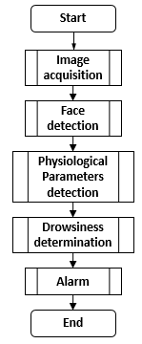
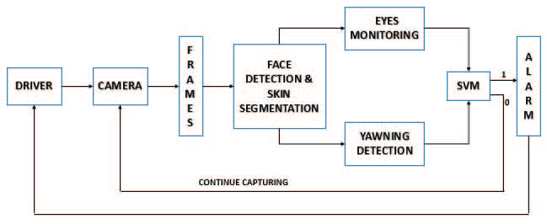
Architecture Diagram.
Method 2
Method 1

Slide 19
Details of Design/Technology
Let’s get started!!

Slide 20
Details of Design/Technology
Face Detection and Segmentation.
For eye tracking a robust CNN proposed by Viola-Jones is used.
K-Means Algorithm is used for Yawning Detection.
The output of all above algorithms is combined to find the final output.

Slide 21
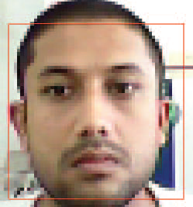
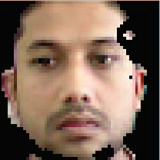
Face Detection and Segmentation
The face detection is done by Viola Jones.
The main aim of face detection is to minimize the false detections in identifying facial expressions.
The importance of this part is to accurately locate the position of the eyes and the mouth.
Once the face is detected, skin segmentation is performed by converting the image to YCbCr domain.
This method detects skin regions over the entire face image and rejects most of the non face image.
Detected face and the corresponding skin regions
Notes:
The face detection is done by Viola Jones [10]. The main
aim of face detection is to minimize the false detections in
identifying facial expressions. The importance of this part is to
accurately locate the position of the eyes and the mouth. Once
the face is detected, skin segmentation [11] is performed by
converting the image to YCbCr domain. The biggest
advantage of converting the image to the YCbCr domain is
that, the influence of luminosity can be eliminated by
considering only the chromatic components. In the RGB
domain, each component of the image i.e red, green and blue
has a different brightness. But, in the YCbCr domain all the
brightness information is given by the Y-component, since the
Cb (blue) and Cr (red) components are completely
independent of the luminosity. The domain conversions are
used to segment the RGB image into Y, Cb, Cr components.
Despite the fact that skin colors differ from person to person,
and race to race, it was found that [11] the color remains
distributed over a very tiny region in the chrominance plane.
This method detects skin regions over the entire face image
and rejects most of the non face image. Fig. 2 shows the
detected face and the corresponding skin

Slide 22
Eye Tracking
The most important factor which helps detect driver fatigue is the state of eyes, i.e. open or closed.
The position of the driver's eyes are determined by using Viola Jones.
If eyes are open then it is treated as the normal state during which the alarm is not set off. If eyes are closed then it is treated as the fatigue state during which the alarm is set on.
Edge detection can be viewed as the process of localizing pixel intensity transitions. There exist several edge detection methods such as Sobel for detecting transitions in the image.
The Sobel edge detection method is also used to detect the eyes’ precise and exact boundaries.

Slide 23
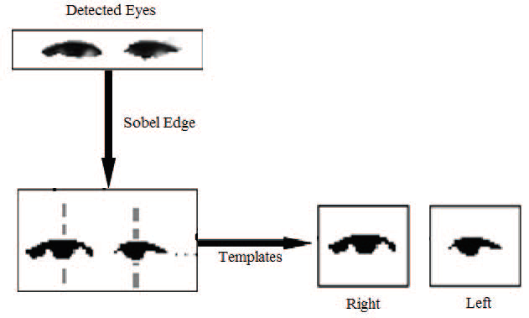
Eye Tracking(Continued)
The detected eyes are segmented from the image and are used to generate an eye template, by this means one can obtain a rather stable eye template for the status analyzing and also reduce the influence of light reflections.

Slide 24
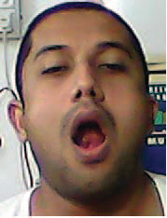
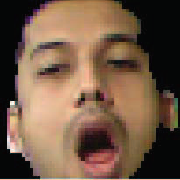

Yawning Detection
Another distinct sign of fatigue during driving, which is manifested in a person’s face, is yawning that occurs due to body reflexes when a person is tired and is about to fall asleep.
Once the regions of mouth area are found using Viola Jones,the mouth region alone is segmented by K means clustering and tracked using correlation coefficient template matching.
The function K-means performs K-Means clustering, by using an iterative algorithm that assigns objects to each clusters so that the sum of distances from each object to its corresponding cluster centroid, over all K clusters, is a minimum.

Slide 25
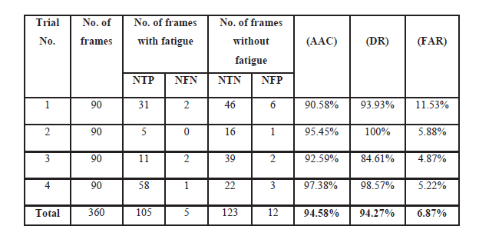
Results
Average accuracy (AAC),
Detection rate (DR)
False alarm rate (FAR)
Where NTP, NTN , NFP and NFN are number of frames in which fatigue has been detected, failed to detect fatigue, no sign of fatigue and the algorithm has not detected any by mistake and no sign of fatigue but the algorithm has detected some by mistake respectively.

Slide 26
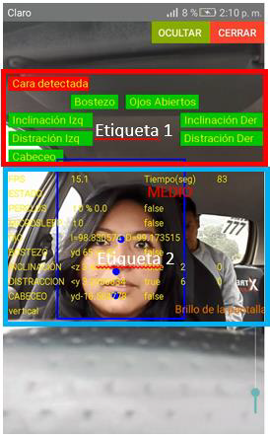
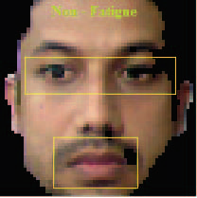
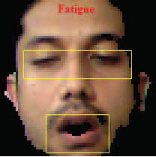
OUTCOMES
Method 2
Method 1

Slide 27
Advantages and Disadvantages
Advantages:
The real time implementation of drowsiness detection which is invariant to illumination and performs well under various lighting conditions.
Correlation coefficient template matching provides a super-fast way to track the eyes and mouth.
The proposed system achieves an overall accuracy of 94.58% in four test cases, which is highest in comparison to the recent methods.

Slide 28
Advantages and Disadvantages
Disadvantages:
Despite the highly satisfactory performance, the system was unable to predict drowsiness when the head was tilted towards right or left.
Head lowering prediction is also to be included with a threshold.
The accuracy drops by 8% with spectacles.
In the future, efforts will be made to make the system rotation invariant.

Slide 29
CONCLUSION
Let’s start with the conclusion.

Slide 30
CONCLUSION
So,I have learnt about the parameters to be considered to detect the drowsiness of the driver.
Also, I have learnt the various techniques to determine the various parameters.
Also, I learnt about the previous research done to solve this problem.

Slide 31
Future Work
To store the time,frequency and how many times a driver shows drowsiness in a database.
To analyse this dataset and generate a detailed analysis for organizational uses.
To create a complete software product which can be used by transportation and logistic firms.
To provide separate login id for each user and admin.
The admin can get the detailed review of each employee by using these system.

Slide 32
REFERENCES
SR no. | References
[1] | E. E. Galarza, F. D. Egas, F. M. Silva, P. M. Velasco, and E. D. Galarza, “Real time driver drowsiness detection based on driver’s face image behavior using a system of human computer interaction implemented in a smartphone,” in Proceedings of the International Conference on Information Technology & Systems (ICITS 2018), Cham: Springer International Publishing, 2018, pp. 563–572.
[2] | B. N. Manu, “Facial features monitoring for real time drowsiness detection,” in 2016 12th International Conference on Innovations in Information Technology (IIT), 2016.
[3] | A. Rahman, M. Sirshar, and A. Khan, “Real time drowsiness detection using eye blink monitoring,” in 2015 National Software Engineering Conference (NSEC), 2015
[4] | Fouzia, R. Roopalakshmi, J. A. Rathod, A. S. Shetty, and K. Supriya, “Driver drowsiness detection system based on visual features,” in 2018 Second International Conference on Inventive Communication and Computational Technologies (ICICCT), 2018.
[5] | M. Kahlon and S. Ganesan, “Driver drowsiness detection system based on binary eyes image data,” in 2018 IEEE International Conference on Electro/Information Technology (EIT), 2018.

Slide 33
References(Continued)
Sr. no. | References
[6] | R. Jabbar, K. Al-Khalifa, M. Kharbeche, W. Alhajyaseen, M. Jafari and S. Jiang, "Real-time Driver Drowsiness Detection for Android Application Using Deep Neural Networks Techniques", Procedia Computer Science, vol. 130, pp. 400-407, 2018. Available: 10.1016/j.procs.2018.04.060.
[7] | W. Deng and R. Wu, "Real-Time Driver-Drowsiness Detection System Using Facial Features", IEEE Access, vol. 7, pp. 118727-118738, 2019. Available: 10.1109/access.2019.2936663.
[8] | S. Mehta, S. Dadhich, S. Gumber and A. Jadhav Bhatt, "Real-Time Driver Drowsiness Detection System Using Eye Aspect Ratio and Eye Closure Ratio", SSRN Electronic Journal, 2019. Available: 10.2139/ssrn.3356401.

Slide 34
THANKS!
Any questions?
You can find me at @npatil2592000 & npatil2592000@gmail.com

